Slide 1



Course: Data Mining
Bachelor Study Programme: Computer Science and Technology
Lesson 4:
Naive Bayes classifier
Spam filters
Ass. prof. E. Pinevich

Slide 2
Learning Objectives
After studying this lesson, you should be able to:
Сlassify data using the Naive Bayes algorithm
Design spam filters

Slide 3
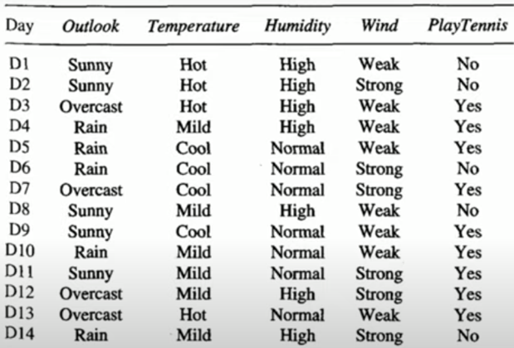
ISSUE 1: Naive Bayes algorithm
There are 14 observations on 4 features.
The tennis game is a target variable with two possible outcomes (yes, no).
Let's calculate the probabilities of "Yes" and the probabilities of "No".
Yes appears 9 times out of 14. Therefore, P(Y)=9/14
No appears 5 times out of 14. Therefore, P(N)=5/14.
We have obtained a posteriori probabilities.
Notes:
For example, it is an architectural design issue whether a computer will have
a multiply instruction. It is an organizational issue whether that instruction will be
implemented by a special multiply unit or by a mechanism that makes repeated
use of the add unit of the system. The organizational decision may be based on the
anticipated frequency of use of the multiply instruction, the relative speed of the
two approaches, and the cost and physical size of a special multiply unit
Many computer manufacturers offer a family of computer models, all with the same architecture but with differences in organization.
In a class of computers called microcomputers, the relationship between
architecture and organization is very close. Changes in technology not only influence organization but also result in the introduction of more powerful and more
complex architectures. Generally, there is less of a requirement for generation to-generation compatibility for these smaller machines.

Slide 4
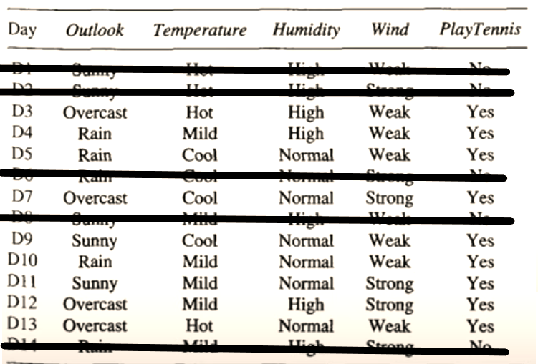
Naive Bayes algorithm
Next, we calculate the conditional probabilities. We have 4 attributes: weather type, temperature, humidity, wind. For each of them, we will calculate the conditional probability.
Let's choose all "Yes“
And let's calculate the probability of "Yes" for each Outlook feature.
PY(Overcast)=4/9,
PY(Rain)=3/9,
PY(Sunny)=2/9.
Notes:
In general terms, there are only four basic functions that a computer can perform.

Slide 5
Naive Bayes algorithm
Let's calculate the probability of "Yes" for each Temperature attribute.
PY(Hot)=2/9,
PY(Mild)=4/9,
PY(Cool)=3/9.
Let's calculate the probability of "Yes" for each sign of Humidity.
PY(High)=3/9,
PY(Normal)=6/9.
Let's calculate the probability of "Yes" for each sign of Wind.
PY(Strong)=3/9,
PY(Weak)=6/9.
Notes:
In general terms, there are only four basic functions that a computer can perform.

Slide 6
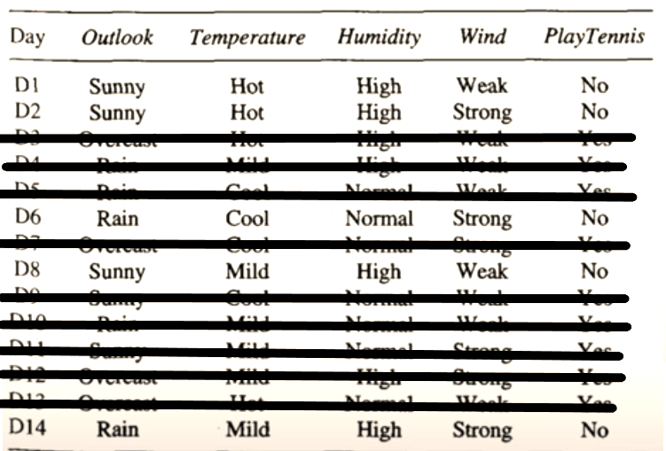
Naive Bayes algorithm
Let's select all "No".
Let's calculate the probability of "No" for each Outlook feature.
PN(Rain)=2/5,
PN(Sunny)=3/5.
Let's calculate the probability of "No" for each Temperature attribute.
PN(Hot)=2/5,
PN(Mild)=2/5,
PN(Cool)=1/5.
Notes:
In general terms, there are only four basic functions that a computer can perform.

Slide 7
Naive Bayes algorithm
Let's calculate the probability of "No" for each sign of Humidity.
PN(High)=4/5, PN(Normal)=1/5.
Let's calculate the probability of "No" for each sign of Wind.
PN(Weak)=2/5, PN(Strong)=3/5.
Notes:
In general terms, there are only four basic functions that a computer can perform.

Slide 8
The data obtained can be entered in the following tables:
P(Play Tennis=Yes)=9/14=0,64
P(Play Tennis=No)=5/14=0,36
Outlook | Yes | No
Sunny | 2/9 | 3/5
Overcast | 4/9 | 0
Rain | 3/9 | 2/5
Temperature | Yes | No
Hot | 2/9 | 2/5
Mild | 4/9 | 2/5
Cool | 3/9 | 1/5
Humidity | Yes | No
High | 3/9 | 4/5
Normal | 6/9 | 1/5
Windy | Yes | No
Strong | 3/9 | 3/5
Weak | 6/9 | 2/5
Notes:
There are four main structural components
■ Control unit: Controls the operation of the CPU and hence the computer.
■ Arithmetic and logic unit (ALU): Performs the computer’s data processing functions.
■ Registers: Provides storage internal to the CPU.
■ CPU interconnection: Some mechanism that provides for communication among the control unit, ALU, and registers.
In recent years, there has been increasing use of multiple processors in a single computer. Some design issues relating to multiple processors crop up

Slide 9
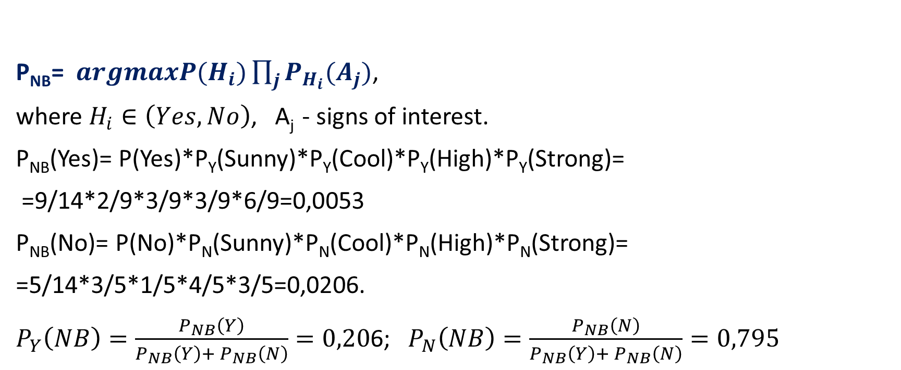
Let's find if a person will play tennis?
If it's Sunny, Cool, High humidity and Strong wind outside.
Let's use the formula:
P_{NB}= $argmaxP(H_{i})\prod_{j}{P_{H_{i}}(A_{j})}$,
where $H_{i}∈\left(Yes, No\right)$, A_{j} - signs of interest.
P_{NB}(Yes)= P(Yes)*P_{Y}(Sunny)*P_{Y}(Cool)*P_{Y}(High)*P_{Y}(Strong)=
=9/14*2/9*3/9*3/9*6/9=0,0053
P_{NB}(No)= P(No)*P_{N}(Sunny)*P_{N}(Cool)*P_{N}(High)*P_{N}(Strong)=
=5/14*3/5*1/5*4/5*3/5=0,0206.
$P_{Y}\left(NB\right)=\frac{P_{NB}\left(Y\right)}{P_{NB}\left(Y\right)+ P_{NB}\left(N\right)}=0,20$6; $P_{N}\left(NB\right)=\frac{P_{NB}\left(N\right)}{P_{NB}\left(Y\right)+ P_{NB}\left(N\right)}=0,795$
Notes:
Computers generally have multiple processors.
When these processors all reside on a single chip, the term multicore computer is used, and each processing unit (consisting of a control unit, ALU, registers, and perhaps cache) is called a core. To clarify the terminology, this text will use the following definitions.
The main printed circuit board in a computer is called a system board or motherboard
The motherboard contains a slot or socket for the processor chip, which typically contains multiple individual cores, in what is known as a multicore processor.
A chip is a single piece of semiconducting material, typically silicon, upon which electronic circuits and logic gates are fabricated. The resulting product is referred to as an integrated circuit.
Another prominent feature of contemporary computers is the use of multiple layers of memory, called cache memory, between the processor and main memory.
Next, we zoom in on the structure of a single core, which occupies a portion of the processor chip. In general terms, the functional elements of a core are:
■ Instruction logic: This includes the tasks involved in fetching instructions, and decoding each instruction to determine the instruction operation and the memory locations of any operands.
■ Arithmetic and logic unit (ALU): Performs the operation specified by an instruction.
■ Load/store logic: Manages the transfer of data to and from main memory via cache.

Slide 10
Next, the highest probability is selected.
Whichever is higher, the object belongs to this class: Yes or No.
Therefore, the new instance is classified as No.
The person will not play tennis under these conditions.
Notes:
The first generation of computers used vacuum tubes for digital logic elements and memory. A number of research and then commercial computers were built using vacuum tubes. For our purposes, it will be instructive to examine perhaps the most
famous first-generation computer, known as the IAS computer. This example illustrates many of the fundamental concepts found in all computer systems.
A fundamental design approach first implemented in the IAS computer is known as the stored-program concept. This idea is usually attributed to the mathematician John von Neumann.
Alan Turing developed the idea at about the same time.
The first publication of the idea was in a 1945 proposal by von Neumann for a new computer, the EDVAC (Electronic Discrete Variable Computer).
In 1946, von Neumann and his colleagues began the design of a new stored program computer, referred to as the IAS computer, at the Princeton Institute for
Advanced Studies. The IAS computer, although not completed until 1952, is the prototype of all subsequent general-purpose computers.
Since the device is primarily a computer, it will have to perform the elementary operations of arithmetic most frequently. These are addition, subtraction, multiplication, and division.
■ Memory buffer register (MBR): Contains a word to be stored in memory or sent
to the I/O unit, or is used to receive a word from memory or from the I/O unit.
■ Memory address register (MAR): Specifies the address in memory of the word
to be written from or read into the MBR.
■ Instruction register (IR): Contains the 8-bit opcode instruction being executed.
■ Instruction buffer register (IBR): Employed to hold temporarily the righthand instruction from a word in memory.
■ Program counter (PC): Contains the address of the next instruction pair to be fetched from memory.
■ Accumulator (AC) and multiplier quotient (MQ): Employed to hold temporarily operands and results of ALU operations. For example, the result of multiplying two 40-bit numbers is an 80-bit number

Slide 11
ISSUE 2: Spam filters
The bottom line is this: the system, which is tasked with determining whether the next email is spam, is pre-trained with a certain number of emails that know exactly where "spam" is and where "not spam" is.
It has already become clear that this is learning with a teacher, where we act as the teacher.
The Bayesian classifier represents a document (in our case, a letter) as a set of words that supposedly do not depend on each other (this is where the naivety comes from).
Notes:
8080: The world’s first general- purpose microprocessor. This was an 8-bit
machine, with an 8-bit data path to memory. The 8080 was used in the first
personal computer, the Altair.
8086: A far more powerful, 16-bit machine. In addition to a wider data path and larger registers, the 8086 sported an instruction cache, or queue, that prefetches a few instructions before they are executed.
80486: The 80486 introduced the use of much more sophisticated and powerful cache technology and sophisticated instruction pipelining. The 80486 also offered a built-in math coprocessor, offloading complex math operations from the main CPU.
Pentium: With the Pentium, Intel introduced the use of superscalar techniques, which allow multiple instructions to execute in parallel.
Pentium Pro: The Pentium Pro continued the move into superscalar organization begun with the Pentium, with aggressive use of register renaming, branch
prediction, data flow analysis, and speculative execution.
Pentium II: The Pentium II incorporated Intel MMX technology, which is designed specifically to process video, audio, and graphics data efficiently.

Slide 12
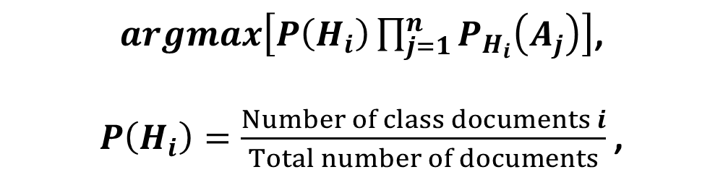
Spam filter
It is necessary to calculate the score for each class (spam/non-spam) and select the one that turned out to be the maximum.
To do this, use the following formula:
$argmax\left[P\left(H_{i}\right)\prod_{j=1}^{n}{P_{H_{i}}\left(A_{j}\right)}\right]$,
$P\left(H_{i}\right)=\frac{Number of class documents i}{Total number of documents}$ ,
Notes:
The integrated circuit exploits the fact that such components as transistors, resistors, and conductors can be fabricated from a semiconductor such as silicon. It is merely an extension of the solid-state art to fabricate an entire circuit in a tiny piece of silicon rather than assemble discrete components made from separate pieces of silicon into the same circuit. Many transistors can be produced at the same time on a single wafer of silicon. Equally important, these transistors can be connected with a process of metallization to form circuits.
A thin wafer of silicon is divided into a matrix of small areas, each a few millimeters square. The identical circuit pattern is fabricated in each area, and the wafer is broken up into chips. Each chip consists of many gates and/or memory cells plus a number of input and output attachment points

Slide 13
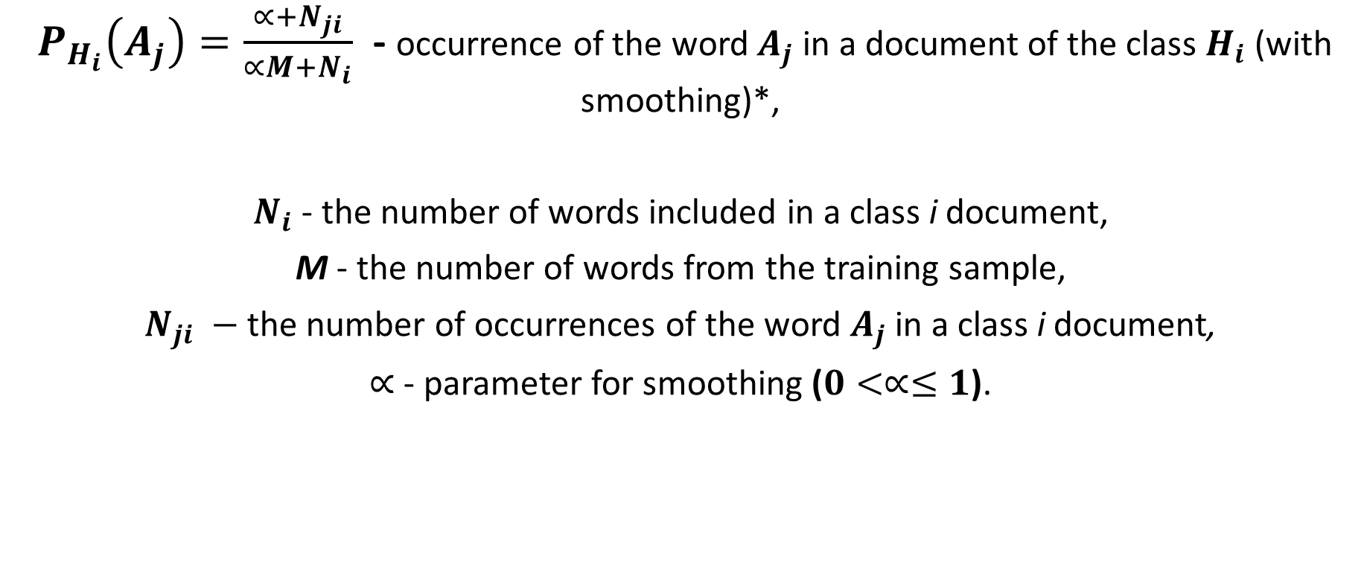
Spam filter
$P_{H_{i}}\left(A_{j}\right)=\frac{∝+N_{ji}}{∝M+N_{i}}$ - occurrence of the word $A_{j}$ in a document of the class $H_{i}$ (with smoothing)*,
$N_{i}$ - the number of words included in a сlass i document,
M - the number of words from the training sample,
$N_{ji} −$ the number of occurrences of the word $A_{j}$ in a сlass i document,
$∝$ - parameter for smoothing ($0<∝≤1$).
Notes:
Moore observed that the number of transistors that could be
put on a single chip was doubling every year, and correctly predicted that this pace
would continue into the near future.
3. The computer becomes smaller, making it more convenient to place in a variety of environments.
4. There is a reduction in power requirements.
5. The interconnections on the integrated circuit are much more reliable than
solder connections. With more circuitry on each chip, there are fewer interchip connections.

Slide 14
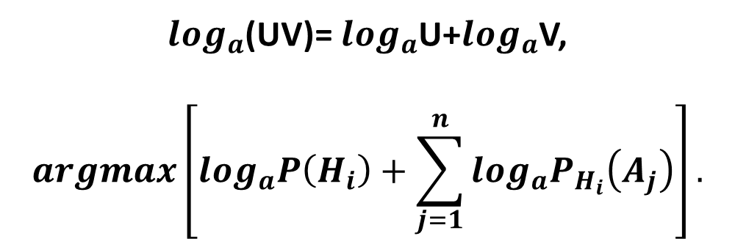
Spam filter
When the text volume is very large, you have to work with very small numbers. In order to avoid this, you can transform the formula by the property of the logarithm.
$\log_{a}$(UV)= $\log_{a}$U+$\log_{a}$V,
$$argmax\left[\log_{a}P\left(H_{i}\right)+\sum_{j=1}^{n}{\log_{a}P_{H_{i}}\left(A_{j}\right)}\right].$$
The logarithm is a monotonically increasing function. As can be seen from the first formula, we are looking for the maximum. The logarithm of the function will reach its maximum at the same point (along the abscissa axis) as the function itself. This simplifies the calculation, because only the numerical value changes.
Notes:
Pentium III: The Pentium III incorporates additional floating- point instructions: The Streaming SIMD Extensions (SSE) instruction set extension added 70 new instructions
Core: This is the first Intel x86 microprocessor with a dual core, referring to the implementation of two cores on a single chip
Core 2: The Core 2 extends the Core architecture to 64 bits.
Core i9 :
Core i9 is a family of high-performance and high core count 64-bit x86 microprocessors introduced by Intel in mid-2017

Slide 15
During the calculations, you may encounter a word that was not present at the training stage of the system. This may result in the score being zero and the document cannot be classified in any of the categories (spam/non-spam).
No matter how much you want to, you won't teach your system all the possible words.
To do this, you need to apply smoothing, or rather, make small adjustments to all the probabilities of words entering the document.
The parameter 0<α≤1 is selected (if α=1, then this is Laplace smoothing).
Notes:
A microcontroller chip makes a substantially different use of the logic space available. Microcontrollers are heavily utilized in automation processes.
Another typical feature of a microcontroller is that it does not provide for human interaction. The microcontroller is programmed for a specific task, embedded in its device, and executes as and when required.
A microcontroller is a single chip that contains the processor,
non-volatile memory for the program (ROM), volatile memory for input and output
(RAM), a clock, and an I/O control unit
The processor portion of the microcontroller has a much lower silicon area than other microprocessors and much higher energy efficiency.

Slide 16
EXAMPLE
Let our system be trained on the following emails, which are known in advance which are "spam" and which are "not spam" (training sample): Spam:
"Low price tour“.
“Offer! Buy a chocolate and get a phone as a gift“.
Not spam:
"There will be a meeting tomorrow“.
"Buy a kilogram of apples and a chocolate“.
Task: determine which category the following email belongs to:
"There's a mountain of apples in the store. Buy seven kilograms and a chocolate“.
Notes:
ARM is a family of RISC-based microprocessors and microcontrollers designed by ARM Holdings, Cambridge, England.
CORTEX-A: These processors run at higher clock frequency (over 1 GHz), and support a memory management unit (MMU), which is required for full feature OSs such as Linux, Android, MS Windows, and mobile Oss
■ Cortex-M0: Designed for 8- and 16-bit applications, this model emphasizes low cost, ultra low power, and simplicity. It is optimized for small silicon die size (starting from 12k gates) and use in the lowest cost chips. ■ Cortex-M0+: An enhanced version of the M0 that is more energy efficient.
■ Cortex- M3: Designed for 16- and 32-bit applications, this model emphasizes performance and energy efficiency. It also has comprehensive debug and trace features to enable software developers to develop their applications quickly.
■ Cortex-M4: This model provides all the features of the Cortex-M3, with additional instructions to support digital signal processing tasks.
■ Cortex-M7: Provides higher performance than the M4. It is still primarily a 32-bit machine but uses 64-bit wide instruction and data buses.
■ Cortex-M23: This model is similar to the M0+, and adds integer divide instructions and some security features.
■ Cortex-M33: This model is similar to the M4, and adds some security features.

Slide 17
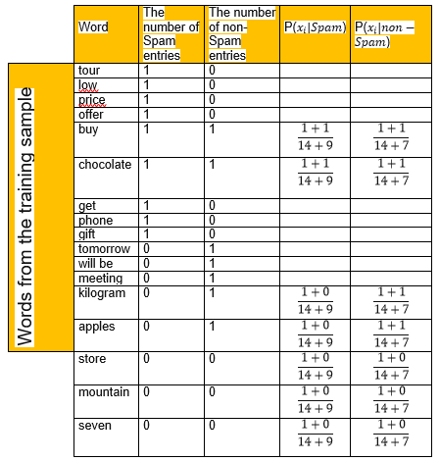
DECISION
Making a table.
We remove all the "stop words", calculate the probabilities, and take the smoothing parameter as one.
Notes:
■ NVIC: Provides configurable interrupt handling abilities to the processor. It
facilitates low- latency exception and interrupt handling, and controls power
management.
■ ETM: An optional debug component that enables reconstruction of program
execution. The ETM is designed to be a high- speed, low- power debug tool
that only supports instruction trace.
■ Debug access port (DAP): This provides an interface for external debug
access to the processor.
■ Debug logic: Basic debug functionality includes processor halt, single- step,
processor core register access, unlimited software breakpoints, and full system
memory access.
■ ICode interface: Fetches instructions from the code memory space.
■ SRAM & peripheral interface: Read/write interface to data memory and
peripheral devices.
■ Bus matrix: Connects the core and debug interfaces to external buses on the
microcontroller.
■ Memory protection unit: Protects critical data used by the operating system
from user applications, separating processing tasks by disallowing access
to each other’s data, disabling access to memory regions, allowing memory
regions to be defined as read-only, and detecting unexpected memory accesses
that could potentially break the system.

Slide 18
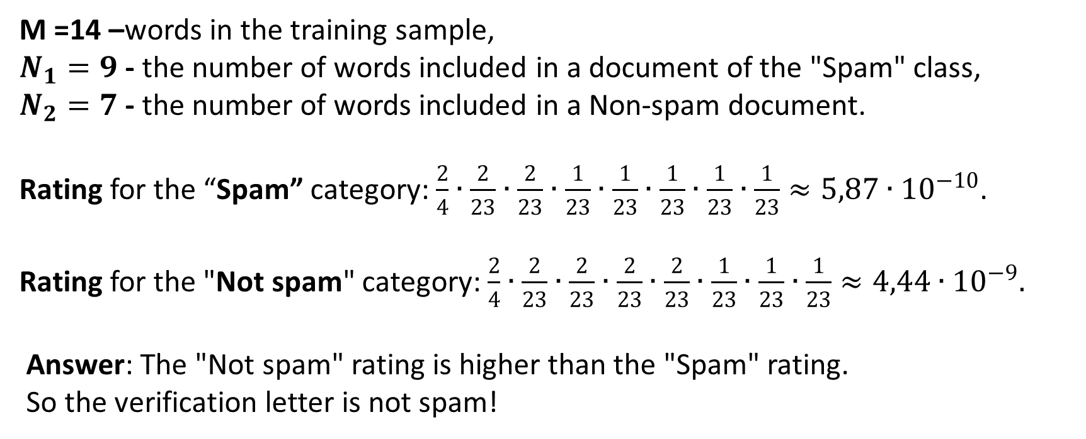
M =14 –words in the training sample,
$N_{1}=9$ - the number of words included in a document of the "Spam" class,
$N_{2}=7$ - the number of words included in a Non-spam document.
Rating for the “Spam” category: $\frac{2}{4}∙\frac{2}{23}∙\frac{2}{23}∙\frac{1}{23}∙\frac{1}{23}∙\frac{1}{23}∙\frac{1}{23}∙\frac{1}{23}≈5,87∙{10}^{−10}$.
Rating for the "Not spam" category: $\frac{2}{4}∙\frac{2}{23}∙\frac{2}{23}∙\frac{2}{23}∙\frac{2}{23}∙\frac{1}{23}∙\frac{1}{23}∙\frac{1}{23}≈4,44∙{10}^{−9}.$
Answer: The "Not spam" rating is higher than the "Spam" rating.
So the verification letter is not spam!
Notes:
■ NVIC: Provides configurable interrupt handling abilities to the processor. It
facilitates low- latency exception and interrupt handling, and controls power
management.
■ ETM: An optional debug component that enables reconstruction of program
execution. The ETM is designed to be a high- speed, low- power debug tool
that only supports instruction trace.
■ Debug access port (DAP): This provides an interface for external debug
access to the processor.
■ Debug logic: Basic debug functionality includes processor halt, single- step,
processor core register access, unlimited software breakpoints, and full system
memory access.
■ ICode interface: Fetches instructions from the code memory space.
■ SRAM & peripheral interface: Read/write interface to data memory and
peripheral devices.
■ Bus matrix: Connects the core and debug interfaces to external buses on the
microcontroller.
■ Memory protection unit: Protects critical data used by the operating system
from user applications, separating processing tasks by disallowing access
to each other’s data, disabling access to memory regions, allowing memory
regions to be defined as read-only, and detecting unexpected memory accesses
that could potentially break the system.

Slide 19
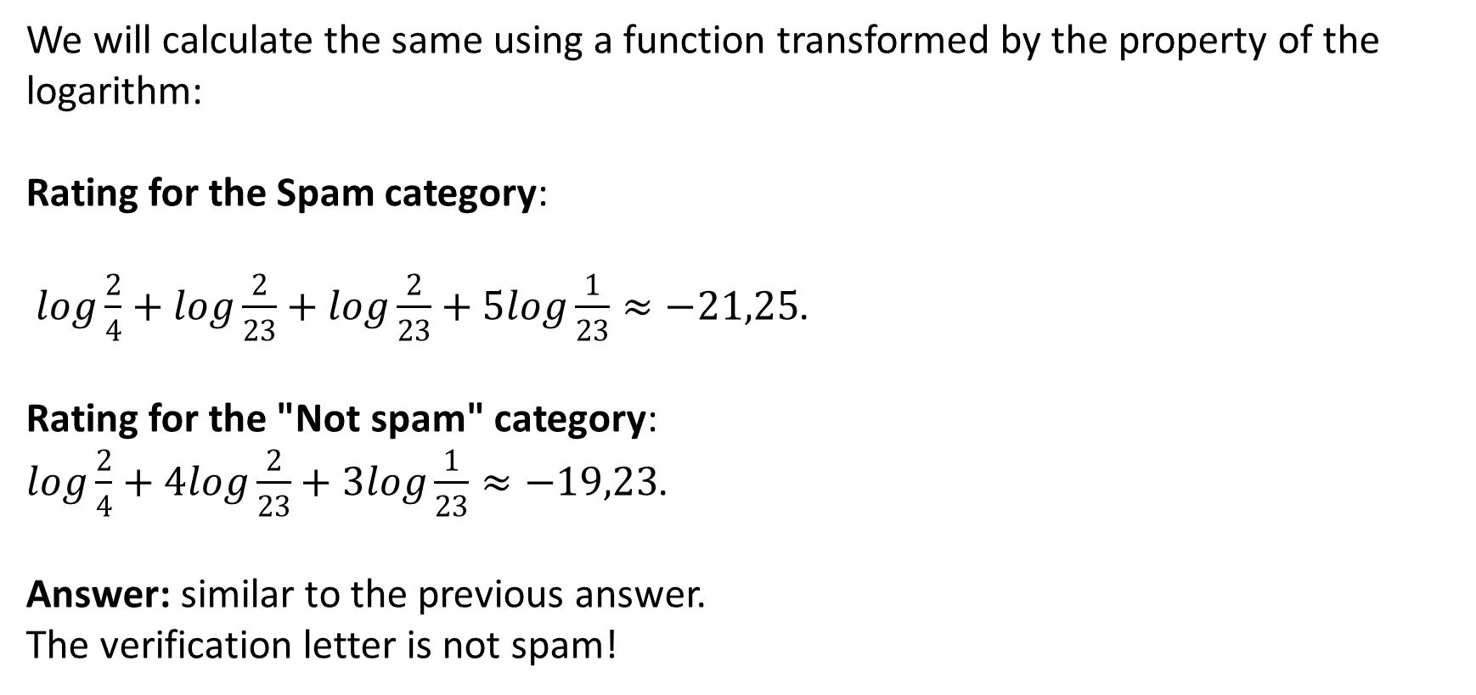
We will calculate the same using a function transformed by the property of the logarithm:
Rating for the Spam category:
$log\frac{2}{4}+log\frac{2}{23}+log\frac{2}{23}+5log\frac{1}{23}≈−21,25$.
Rating for the "Not spam" category:
$log\frac{2}{4}+4log\frac{2}{23}+3log\frac{1}{23}≈−19,23$.
Answer: similar to the previous answer.
The verification letter is not spam!
Notes:
■ NVIC: Provides configurable interrupt handling abilities to the processor. It
facilitates low- latency exception and interrupt handling, and controls power
management.
■ ETM: An optional debug component that enables reconstruction of program
execution. The ETM is designed to be a high- speed, low- power debug tool
that only supports instruction trace.
■ Debug access port (DAP): This provides an interface for external debug
access to the processor.
■ Debug logic: Basic debug functionality includes processor halt, single- step,
processor core register access, unlimited software breakpoints, and full system
memory access.
■ ICode interface: Fetches instructions from the code memory space.
■ SRAM & peripheral interface: Read/write interface to data memory and
peripheral devices.
■ Bus matrix: Connects the core and debug interfaces to external buses on the
microcontroller.
■ Memory protection unit: Protects critical data used by the operating system
from user applications, separating processing tasks by disallowing access
to each other’s data, disabling access to memory regions, allowing memory
regions to be defined as read-only, and detecting unexpected memory accesses
that could potentially break the system.

Slide 20
Key Terms
data table facility object feature | classification algorithm sign attribute predict target | Naïve Baies algorithm Learning with a teacher
Notes:
Today we have studied the following concepts
In the next lecture, we will repeat these concepts. You should explain their meaning in a few words. Everyone understands this ?
Until the next lecture

